Slide 1
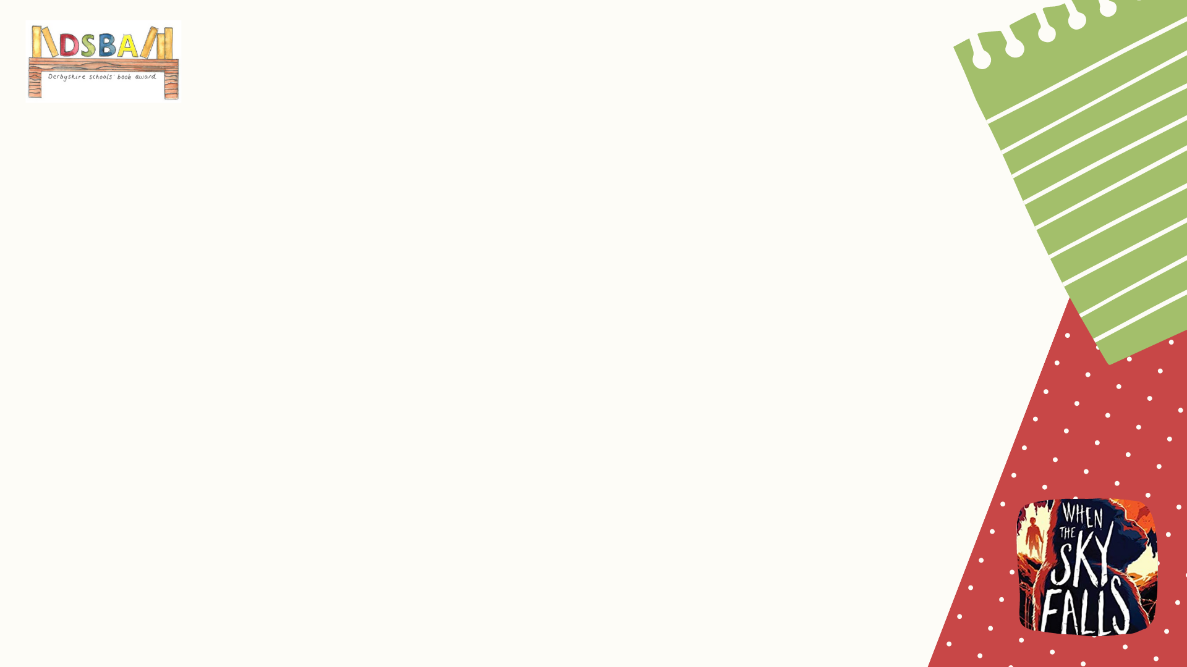
Match the word to the meaning
German bomber - Shrapnel - Blackout paint - The Blitz – Jerries – Evacuee
Home guard – Air-raid siren - Air-raid – Nazi - Luftwaffe – Ration book
Wireless – Identity card – Allotment - Platoon – Bobby - Air-raid shelter - Gas mask
When people bought food the shopkeeper crossed the items off in this.
This was carried everywhere in a box and worn if there was a gas attack.
Heavy and frequent bombing attacks by German bombers.
A child who has been moved away from the town or city to the countryside.
A place to grow vegetables.
Loud and long signal or warning sound before an air-raid.
Enemy attacks from the German air force.
A member of the National Socialist German Workers' Party.
A Luftwaffe aeroplane that dropped bombs onto enemy targets.
Volunteer part-time soldiers.
Radio.
Projectiles (shells) containing small shot or bullets along with an explosive charge.
A name for German people and soldiers.
Paint that was used to cover windows to prevent any light from leaking out at night that might aid enemy bombers.
A card that was carried at all times containing your name and address.
A military unit, for example ‘rifle platoon’, containing soldiers and commanders.
Police officer.
A temporary shelter to protect you from falling bombs and buildings.
The German air-force.

